Slide 1
Reinforcement learning project process Tzlil Zarif Gil Magen ishay Lankry

Slide 2
UNITY
in Unity, we used a written guide in order to build a simple 2D game where a ball tries to dodge particles without any user inputs. we finished building the game itself and started to build the AI (reinforcement learning using ML-Agents toolkit based on pytorch Unity extensions. we had some unsolved issues and errors when tried to run the game without using the reinforcement learning (we have tried to test the game with user inputs (heuristic))

Slide 3
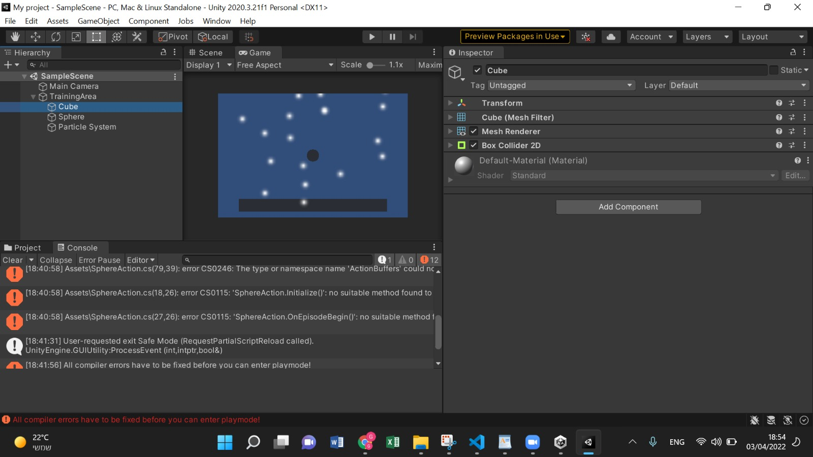

Slide 4
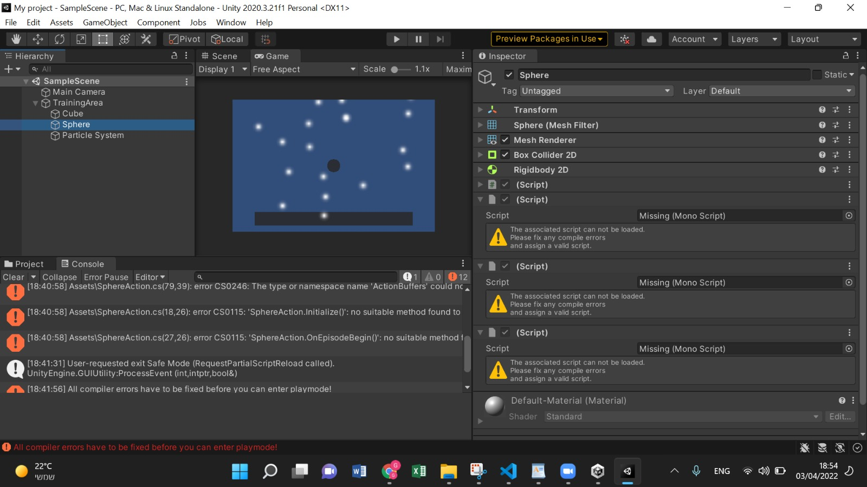

Slide 5
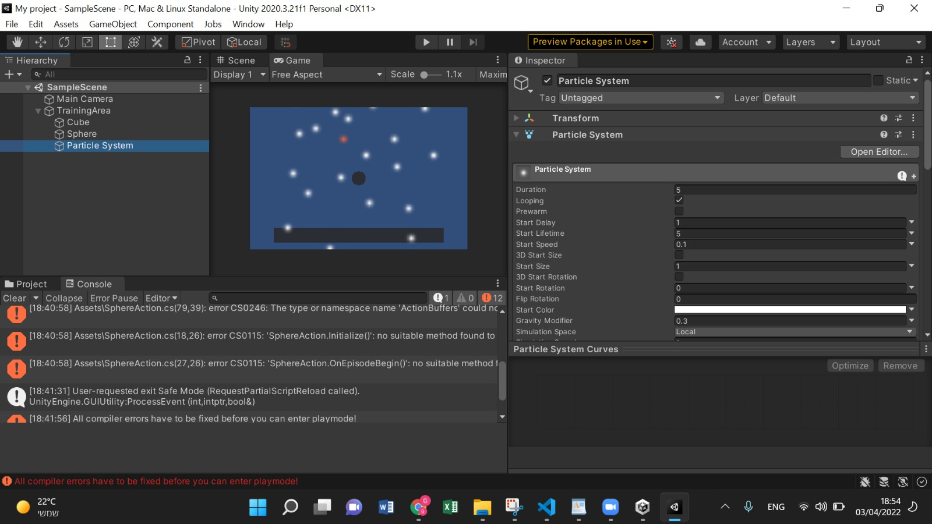

Slide 6
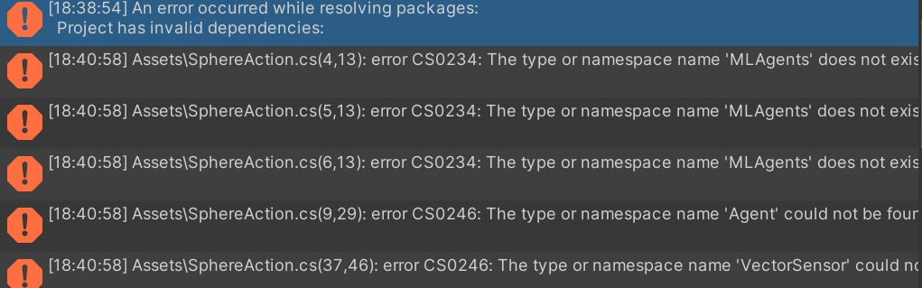
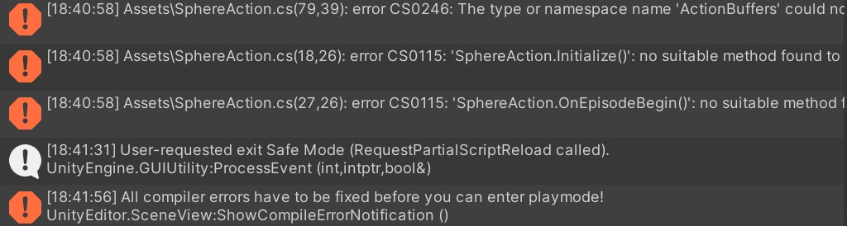

Slide 7
Link to the tutorial- here

Slide 8
Java Script-
In this case, we used an AI tutorial in JS and tried to build a 2D flappy bird game. We had several difficulties due to lack of knowledge in the field of reinforcement learning using JS. We've tried to change few variables in order to see how it affects the game and the learning process. After a short run of the game, it suddenly stopped working with no visible reason.

Slide 9
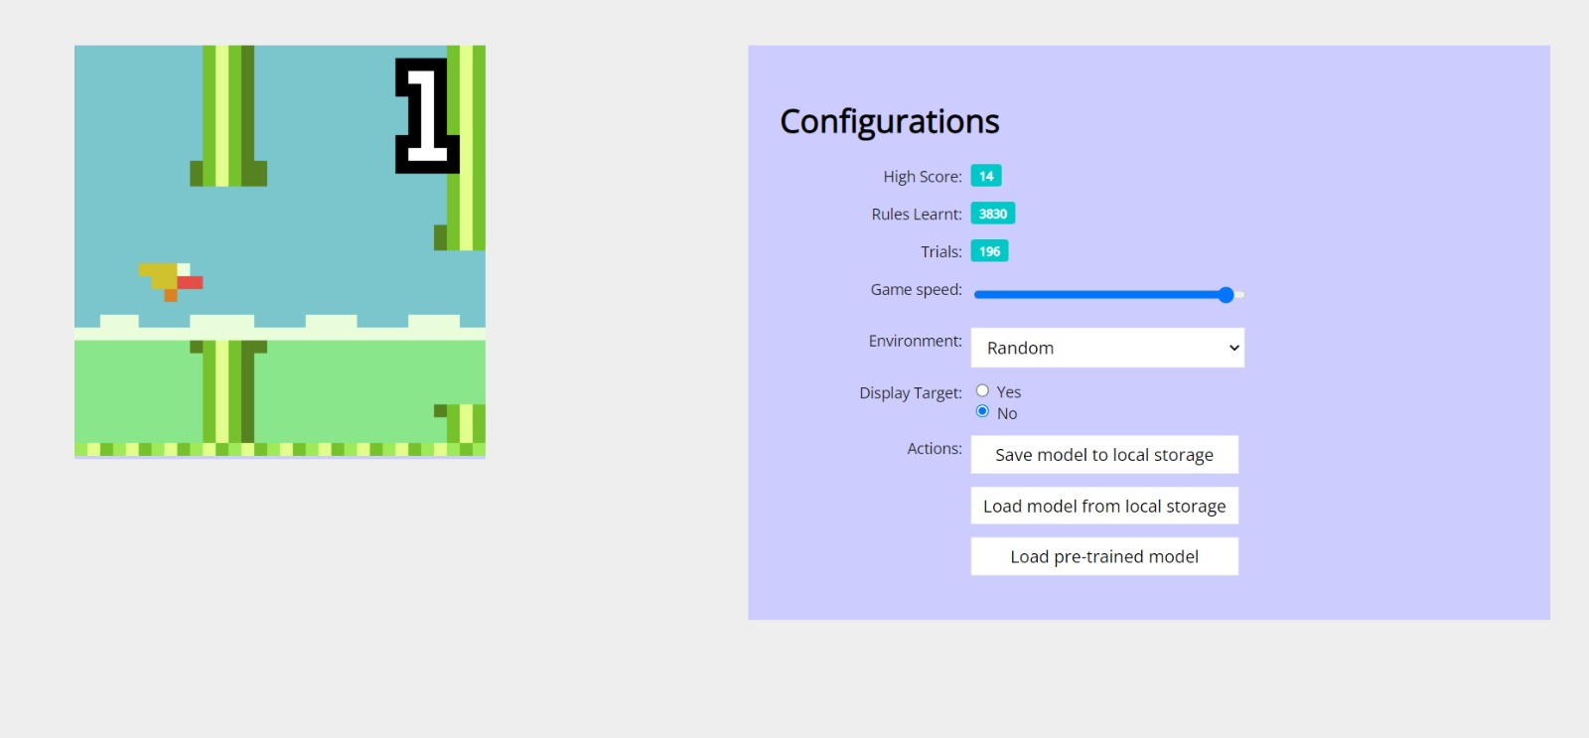
Link to the game here

Slide 10
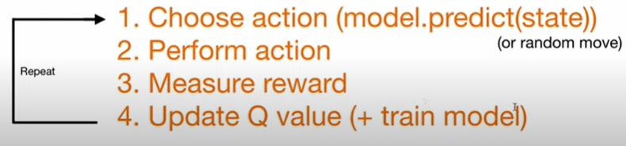
pytorch + pygame- vs code -current project
Type- deep Q learning (quality of action).
Rewords- eat food: +10 game over: -10 else: 0
Actions- straight [1,0,0] right turn [0,1,0] left turn [0,0,1]
States- (11 values)
[danger straight, danger right, danger left,
direction left, direction right, direction up, direction down,
food left, food right, food up, food down
]
state
model
action

Slide 11
Introduction
In this project we created an ai snake game, using python (pycharm)
We have added some features to the game in order to test the snake's choices, whether he'd prefer the higher score food, or the food which is closer to him physically
We also raised the snake's speed every iteration in order to make it harder for the algorithm
We have added some features to the game in order to test the snake's choices, whether he'd prefer the higher score food, or the type of food which is closer to him at the monent

Slide 12
The main features
basic apple
Bad apple
Best apple
Dynamic apple
Speed raise

Slide 13
The basic apple – red
Color: red
Score: +1 point
Special features: After the snake eats the a red apple, it’s size gets one pixel longer.

Slide 14
Bad apple - white
Color: white
Score: -5 points
Special features: negative score If the total score <= 5: The game is over
If the total score >=5: The game continues, but the snake will lose 5
points

Slide 15
Best apple - yellow
Color: yellow
Score: +5 points
Special features: The score is higher than the regular score.

Slide 16
Dynamic apple- Multicolor
Color: Multicolor- any time we’ll start the game the color will be different.
Score: The score will be changed every time- you don’t know what will be the apple’s score before you eat it and any time it will be different. The score’s range will be between -5 to +10
Special features: this apple is different then the other apples, his color and score are dynamic, and the score can be the highest or the lowest.

Slide 17
Speed raise
Special features: After the sneak will eat an apple, the score will be raised, and the snake will move faster each round. The speed will only raise up and not down- If the snake eats a bad apple, he won’t get slower.

Slide 18
Run time video explanation
We can see on the video of the game that once we start running it, the system doesn't know how to navigate the snake and what's the purpose of the game. after a few minutes when it starts getting a "feedback" as a score (award) from each apple, it can learn what's "good" and what's "bad" according to the score it gets (negative/positive and the score rate) it loses the game every time it hits the wall or himself, which helps him to understand the game's purpose.
A challenge we've added to the game is the speed raise, so it takes time for the snake to learn how to behave after every iteration.

